Slide 1

Budgeting
ANN Las Vegas – March 2016
Andy Schuricht
Valor CSR
Lecturer in Social Entrepreneurship, UNLV
andy@valorcsr.com

Slide 2

Budgeting: Habitat
Notes:
Let’s see who we have in the room.
Organizations with zero paid staff With no budget currently OR With a budget (Who does it, you or someone else?)
Organizations with one paid staff person With no budget currently OR With a budget (Who does it, you or someone else?)
Organizations with more than one paid staff person With no budget currently OR With a budget (Who does it, you or someone else?)
Notice that the size of an organization (and paid staff) is correlated with having a budget.

Slide 3

Budgeting: Habitat
Notes:
Where can budgets be found? What purpose do they serve? There are three primary ones. I’ll take them from least to most important. There are others, including the State of Nevada Charitable Solicitaiton Registration Statement, which, if you file a 990-N, commonly called the e-postcard, requires that you report current year estimates.

Slide 4
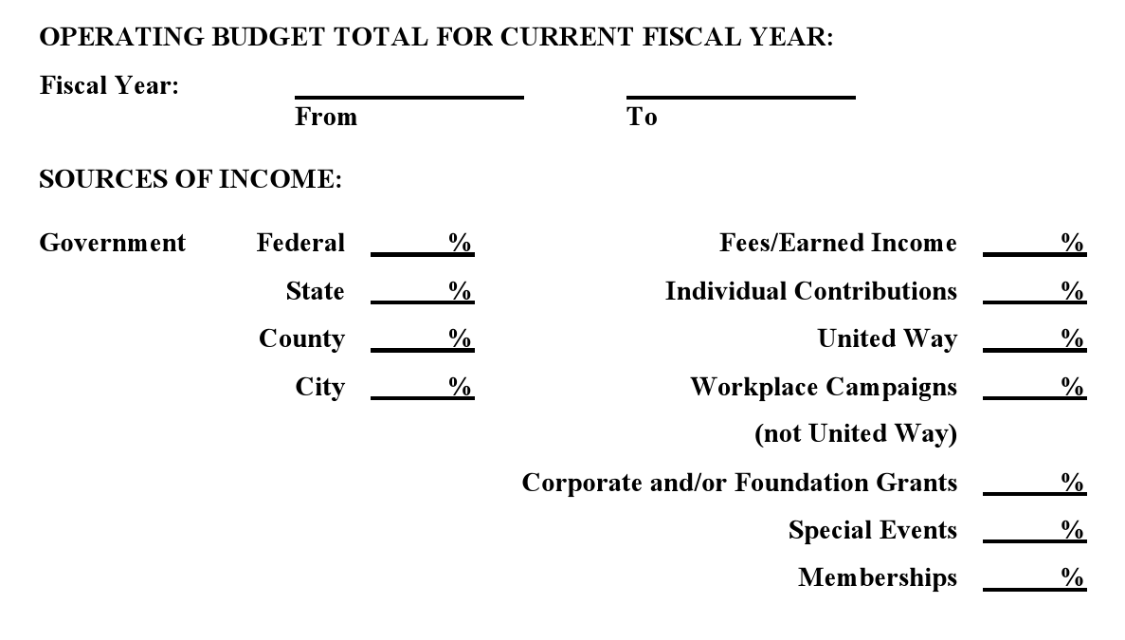
Budgeting: Grants - Income
Notes:
This is taken from an actual grant application. For those of you with no budget, how would you be able to answer this question?

Slide 5
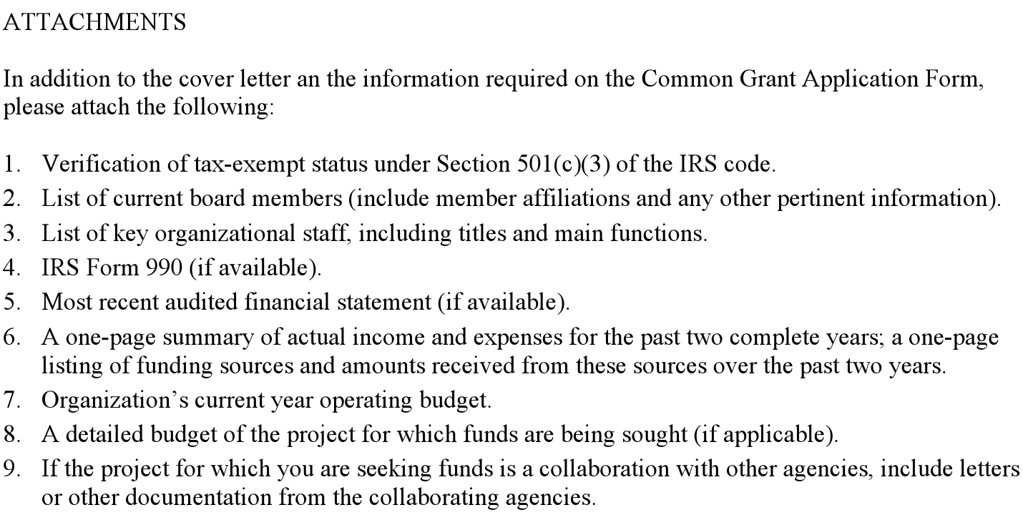
Budgeting: Grants - Expense
Notes:
Grants applications require it (See grant application form)
Not only do they require a basic “operating budget” but, many want you to slice and dice this data in zillions of different ways, including:
Percent of revenue from different sources
“Program Specific” budget
External sources of revenue
And a large fraction of the time, they want you to cram your budget into their budget template, which never matches up with your normal budget

Slide 6
Budgeting: Planning
Expenses
How do you know if an expense is appropriate?
Revenue
    (This is actually impossible, right?)
Cash Flow
  What is that, exactly?
Notes:
Expenses: How do you know if it’s wise to commit to an expense? Wouldn’t it be great if there were something that tells you that it’s okay to spend that money because you expect to cover it with revenue?
Revenue: This is impossible, right?
Cash flow: This is actually the most important part, because even if you get your budget 100% correct, you can’t typically spend money before you receive it (without a loan).

Slide 7

Budgeting: Goals
Tips for chunks:
Each chunk must be attainable
You get immediate feedback if you miss the target of a chunk
Notes:
Let’s taking working out as an example. Is anybody here a runner? Treadmill or outside? So there’s something really important about being an “outside runner” and that’s that you need to have some idea of where to turn around, or you’re stuck walking a long way home (or calling an Uber.) So imagine that your workout routine includes an run. And the book says “just run”. At this point a bunch of people would just take their shoes back off and watch a House Hunters International marathon. The rest would just go out and ran until they got tired, or thought it was a good place to turn around, or whatever. What’s the likelihood that you’re running the correct speed and distance for your ability? None.
What you need is a goal. Say you’re going go 5k. Great! Then you have a distance you can start preparing for. Do you spend most of your time on the couch watching HHI? No problem. Then you know you’re going to need to take it slow. Make a graduated plan — run for 1 minute and walk for 5 - until you get to your distance.
Ok. So what on earth does that have to do with budgeting again?

Slide 8

Budgeting: The Yo-yo method
Step 1: Start at the top
Step 2: Go to the bottom
Step 3: Go back to the top
Notes:
Yoyo method
How does a yoyo work? You start at the top, go all the way to the bottom, and then roll it back up to the top again. It doesn’t work any other way. Let’s try.

Slide 9
Budgeting: The Yo-yo method
Step 1: STRATEGIC PLAN
Step 2: Go to the bottom
Step 3: Go back to the top
Notes:
So, in our analogy, the top of the yoyo is:
The Strategic Plan
That’s the “goal and chunk thing”.
“Yeah, but what if I don’t have a strategic plan?”
Um. Get one first.
From here on out we’re going to assume that you know two things:
1. The mission of your organization
2. Your short term goals (1 to 3 year).
Once you have that, you’re going to want to start the process of breaking those goals up into individual tasks. Depending on the age/size/complexity of your organization, your goals may be either very high level or very low level. Either way, that’s okay. You can use this template to turn them into a budget.

Slide 10

Budgeting: Think like a 3-year-old
Notes:
This method is so easy even a two year old can do it. In fact, it was actually invented by a two year old. Probably one climbing a tree at night.
Anybody want to play this game with me now? By the way, I get to be the two year old.
…
At the end of this incredibly irritating process you should have a bunch of tiny little items that you can assign dollar amounts to. Not only that, you should also have a sense of when this money is coming in, or when this money is going out.

Slide 11
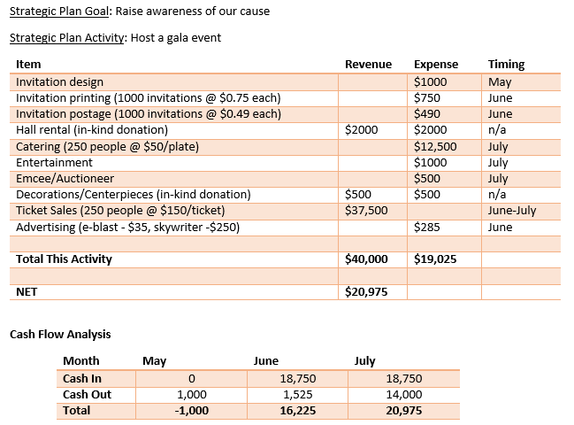
Notes:
So here’s a sample budget template that I might use for an event:
This isn’t a strategic planning session so we shan’t go into whether or not that activity truly supports the goal (or how you’re measuring it.)
Putting the timing on each expense also gives us an idea of how our overall bank account is going to fare with this event. In the example, we’re going to need to dip into our account by $1000 in May in order to get things started.
One of the cool effects of doing it this way is that you get to see where your breakeven points are. Since catering and ticket sales move in unison, we could actually figure out the minimum number of tickets we need to sell to make any money on this. (For those of you really quick with math (or clever in Excel) you need to sell 41 tickets.)
Anybody notice anything that deviates from reality on this? How about that we’re budgeting ticket sales of 250?
So let’s dip into a little budgeting philosophy for a moment.
Given two options, which is better? Budgeting for fantasy or reality?

Slide 12

Budgeting: Important truth #63
BUDGET FOR REALITY
Notes:
In our example we just gave, we were budgeting for fantasy, right? So here’s important truth number 63.
IMPORTANT TRUTH #63: BUDGET FOR REALITY
Let’s look at the event budget one more time. 250 tickets sold out of 1000 invitations. Does that sound reasonable? Maybe. Is it agressive? Maybe.

Slide 13
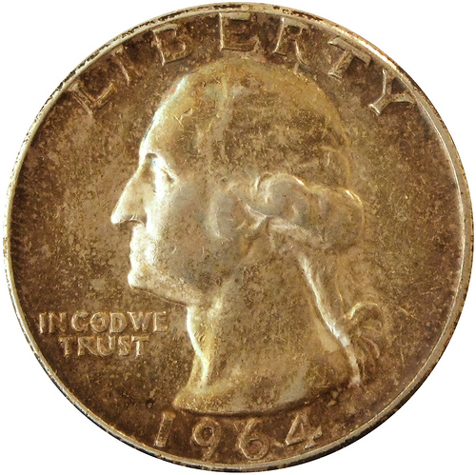
Budgeting: Methods of Estimation
There are three methods of estimation:
Comparisons with known values for the population
Subjective estimates
Extrapolation
Strengthener: Group confirmation
Notes:
How can you tell? There are three methods of estimation;
1. Comparisons with known values for the population
2. Subjective estimates
3. Extrapolation
One of the really interesting thing about estimates is that the more people that you involve in making the estimate, the more accurate it can become. Take an incredibly random event, such as the flipping of a coin. We’ll do this now. How many heads? How many tails? The answer, of course, is that there’s a 50% chance of either outcome, which the room just confirmed by voting. The more people we have in the room, the closer we would have come to the exact 50% number. And remember — that event is totally random.
Using estimation methods above plus group confirmation will get you incredibly close to the actual amount.
Which brings us to:

Slide 14
Budgeting: Revenue
Why?
How?
Notes:
Is anybody doubting me so far? Does this seem like magic to you? Questions?
Does everybody feel like they have a pretty good handle on budgeting for expenses? Okay, let’s move on to budgeting for revenue.
Now this is well and truly magic, isn’t it. Budgeting for fundraising. How could you possibly even know?
But I’ve already given you the answer. Bottom of the yo-yo group estimating. The real question is, how far down can the yo-yo go? All the way down.
The following process works for grants and individual gifts. Budgeting for direct mail revenue is a completely different discussion.
Here’s how it works:
You need donations (how)
People are going to give you money (how)
We are going to ask them (how)
In person (how)
Well, we’re going to do research on how much we think they can give, and then we’re going to ask them. (how)
We’re going to start with a list of names and then assign the amount that we think we’ll ask them for, and how likely we think they are to say yes.

Slide 15
Budgeting: Revenue
Start with a list of names
Assign the amount that we think we’ll ask them for
Determine how likely we think they are to say yes (with group confirmation)
This is the weighted average trick
Notes:
This is called the ‘weighted average” method. The more data points you put into it , e.g., the more donors you have, the more accurate this becomes.

Slide 16
Budgeting: Revenue

Slide 17
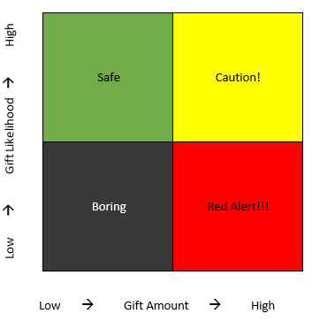
Budgeting: Revenue - Risks
Bad estimates
Danger zone gifts
Very small data sets
Notes:
There are risks! Bad estimates can be counteracted by a good estimation process. Danger zone gifts are ones that you may want to consider discounting further because the chance that you get them wrong can be catastrophic. Very small data sets should be replaced with larger data sets. For example, for small, no-staff organizations, you may consider including your board in the individual giving revenue development process. This can actually be helpful in multiple ways, too.

Slide 18
Budgeting: The Yo-yo method
Step 1: STRATEGIC PLAN
Step 2: THINK LIKE A 3 YEAR OLD
Step 3: Go back to the top
Notes:
Recap!

Slide 19

Budgeting: Final assembly
Notes:
The last step is to take all of your data and turn it into something we would normally call a budget. The document that most people refer to as a budget is really just a summary of a budget. In other words, it’s compressed down into categories so that you don’t have to look at 700 spreadsheet lines to get the big picture. This is why it’s so irritating to cram your budget into a grant template if you’ve only ever created a budget summary.

Slide 20
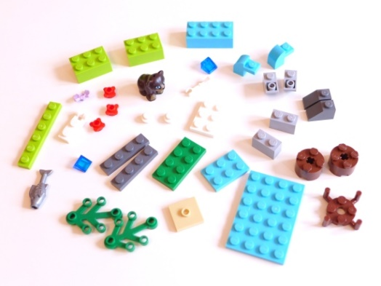
Budgeting: Final assembly
Notes:
Only by starting with the individual pieces are you able to reassemble your summary budget in a way that satisfies every user. For planning purposes, you may want to recombine it one way. For a grant, you’re inevitably going to need to recombine it a different way. For reporting a budget to actual, you’re going to recombine it still another way.

Slide 21
Budgeting: Final assembly
Description
Request Amount (revenue only)
Likelihood (revenue only)
Budgeted Revenue Amount (revenue only)
Budgeted Expense Amount (expense only)
Category*
Program Activity
Timing
Notes
* For example Categories, check with whoever does your bookkeeping (or Form 990), or check out http://nccs.urban.org/projects/ucoa.cfm
Notes:
Here are the only fields you need for both a revenue and expense budget that can be recombined in infinite ways. Categories and program activities are important in that it gives you the ability to mash together different types of revenue and expense into different combinations. For very complex budgets, you may only need to add one or two more fields, such as GL Code (if you’re using a sophisticated accounting system) or Person Assigned if you want to attach a particular fundraiser to a particular donor. For smaller organizations, you can simply use Excel to do this. Really big organizations typically either invest in budgeting software, use the “budgeting module” of their accounting package, or design a budget database from scratch. Many organizations simply use Excel.

Slide 22
Budgeting: Final assembly
Notes:
If you’re using Excel, make sure you take advantage of the pivot table. Either read up on it in the help files, or find an Excel geek to help you. It will make your budget rollup much easier.

Slide 23
Budgeting: The Yo-yo method
Step 1: STRATEGIC PLAN
Step 2: THINK LIKE A 3 YEAR OLD
Step 3: CATEGORIES AND CODES

Slide 24
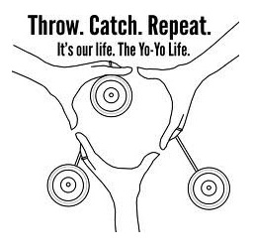
Budgeting: The Yo-Yo Life
When revenues cannot cover expenses
You should:
  Modify strategic plan goals, or
  Operate at a deficit
You should not:
  Juice the revenue budget
  Violate rule #63
Notes:
There is an interesting effect of budging this way, which you can also file under budgeting philosophy and that is that this method of budgeting manages to avoid budget inflation. In many organizations, budgets are developed by “taking last year’s numbers and adding 10%” or some similar process. This is done for several reasons, the most obvious of which is probably laziness (or an unwillingness to really act like a 3 year old or carefully consider your estimation methods.) Another insidious form of budget inflation is “I know that my budget is going to get cut, so I always ask for more than I need so I’m okay.” This is a really slippery slope because once everyone starts doing it, you begin to violate the “budget for reality” rule. In which case, you might as not even bother. By being consistent and always going back to the Strategic Plan for modifications, you avoid this because you’re never asking staff to hit their goals with inadequate resources.
And one final note. Be flexible with adherence to your budget. Allow staff (and yourself) to be creative in ways to save money, and constantly thinking of smart future investments. In other words, if you have to go over budget a little bit this year so that you can save a ton of money next year, don’t let the budgeted figures prevent you from making smart decisions.

Slide 25
Budgeting: Recap
Budgets and organization size are positively correlated
Purpose of a budget: GOALS, planning, grants
Budget using the yo-yo method
  Top: Strategic Plan, divided into actionable chunks
  Bottom: Ask questions like a three year old to reach budgetable items
    Including timing information for cash flow purposes
    Budget for reality
    Three methods of estimation
    Use group confirmation and the weighted average trick
    Watch for estimation risks
  Top: Add categories and codes
Balance by adjusting the Strategic Plan
Budgerigars are indigenous to Australian scrubland
Notes:
Recap!

Slide 26

Budgeting: Questions?

