Slide 1
Nevada’s Big Give
Training for Nonprofits
Part I of II: Getting Started on Razoo
powered by

Slide 2
Getting Started on Razoo
1. Claim ownership of your nonprofit on Razoo.
2. Customize your page.
3. Contact us – we’re here to help!

Slide 3
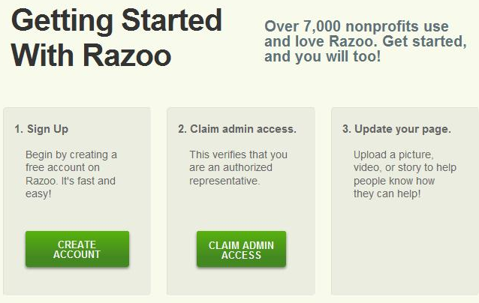
Claim Ownership of your Page
Start at http://www.razoo.com/p/for_nonprofits
Create an account by providing your name, e-mail address (should reflect nonprofit’s name) and creating a password.
Claim admin access. We will send an e-mail when you have been approved to administer your nonprofit.
Notes:
Encourage nonprofits to use the e-mail address they have that is associated with their nonprofit ex: Jane@npo.org instead of Jane@gmail.com.
The approval e-mail comes from do-not-reply@razoo.com, so have them check their spam folder if they do not see the e-mail within a day or 2 of applying.
There is no limit to how many members of an organization can have admin access. We do verify that they are recognized by the nonprofit as having the ability to view donor information.
Admin’s will receive e-mail notifications when donations are made and have access to a full donation report.
Some nonprofits will create a general log-in for everyone at their organization (ex: info@npo.org) and share the password. Whether they create individual Razoo accounts or just have one generic log-in is up to their personal preference, but the e-mail address does need to be a valid and accessible e-mail account.

Slide 4
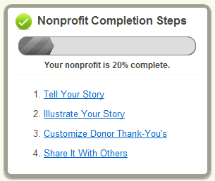
Customize Your Page
Log-in to your account with admin access and click My nonprofit on the right side of the header.
Use the admin tool bar or the completion steps to explain, illustrate and promote your cause.
4
Notes:
The admin tool bar consists of the blue links: view, edit, images/videos, thank donors, share, donations, matching grants.
As they update their page, the steps in the “nonprofit completion steps” box will disappear.
Only the admin will view the “nonprofit completion steps box.” This will NOT be visible to anyone else (donors, visitors, etc), only to the person logged-in to the admin account(s)

Slide 5
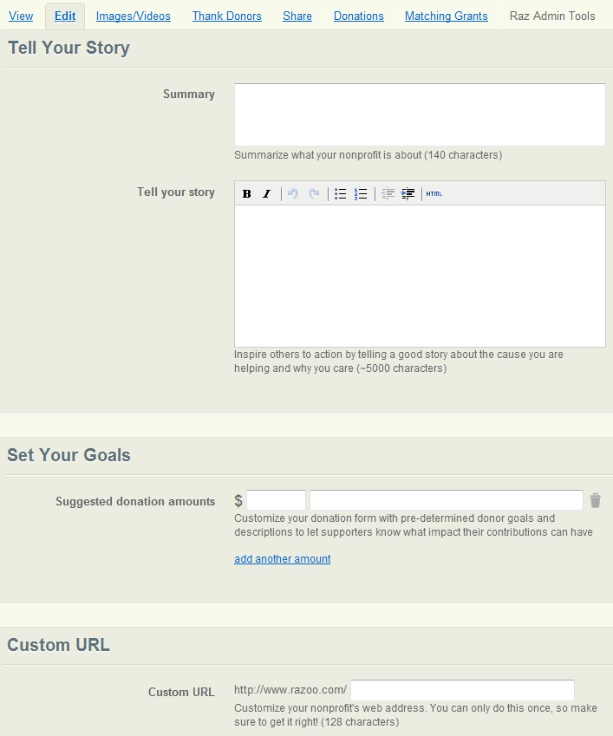
Customize Your Page: Edit
Include your mission statement in Summary.
Explain the work of your nonprofit in Tell Your Story.
Highlight the value of a donor’s contribution by adding Suggested Donation Amounts under Set Your Goals.
Personalize your page’s web link by creating a Custom URL.(Note: This can only be done once.)
Notes:
To add additional suggested donation amounts, click the blue link “add another amount.” The dollar amount field only accepts numerical values, no $ , or .
The custom url can only be updated once.

Slide 6
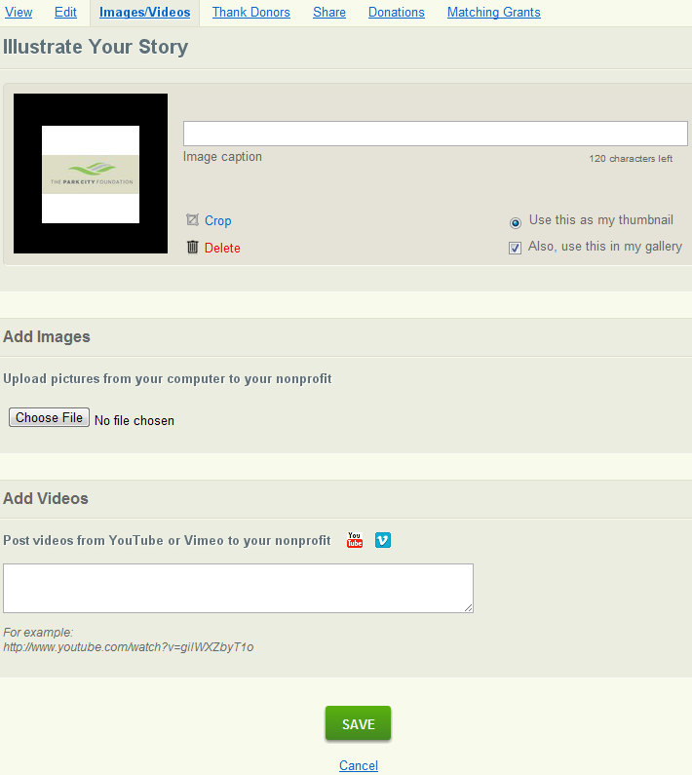
Customize Your Page: Images/Videos
Show your nonprofit at work by uploading images and videos.
Use multiple images with captions to tell a story.
Notes:
After choosing a file or adding a url, they need to click “save” for it to upload. They will then have the ability to add a caption, and indicate which image they would like to use as their logo/thumbnail.

Slide 7
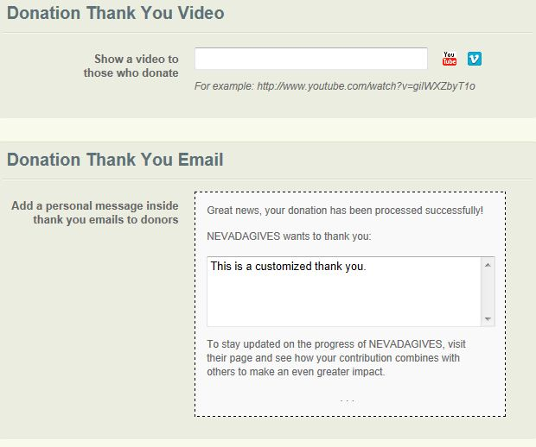
Customize Your Page: Thank Donors
Upload a thank you video for donors to view after making a contribution.
Include a message in your donors’ tax receipts to express your appreciation.

Slide 8
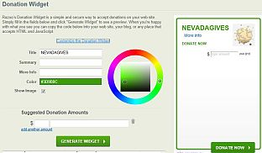
Customize Your Page: Share
Spread the word via Facebook, Twitter, and e-mail.
Customize and embed a Donation Widget to allow donors to give right on your website or blog.

Slide 9
Customize Your Page: Share (continued)
Choose a Donate Now button (Click “See More Buttons to see variations on the button below) to link donors from your website to your page on Razoo.
Copy/paste generated HTML on to your web page.

Slide 10
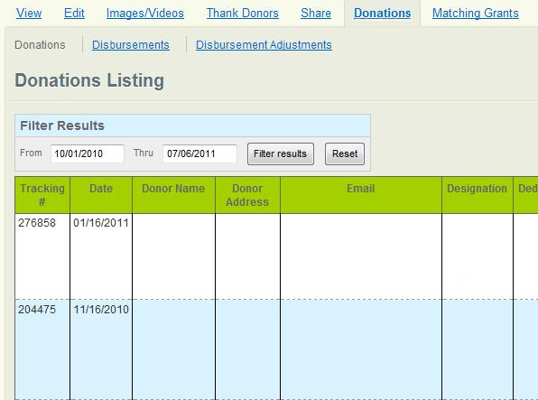
Customize Your Page: Donations
Click the Donations tab to view donor information filtered by date and download the report into a CSV file.
To view information related to the monthly disbursement check from Razoo, click the link labeled Disbursements.
Notes:
The donation form contains the following pieces of information: tracking number, date of donation, donor name, donor physical address, donor e-mail address, designation (donors can designate their donation, or if they donate through a fundraiser or project, the page creator can pre-designate all donations made through that page), dedication (donors can give in honor of someone), source (name of the page through which the donation was made), page creator (name of the fundraiser or project creator), repeats (if it is a recurring donation), payment method (credit card), origin (whether the donation was made through the Razoo page or through the Donation Widget), refund (when applicable), team name (if the page through which the donation was made was associated with a team), and amount.

Slide 11
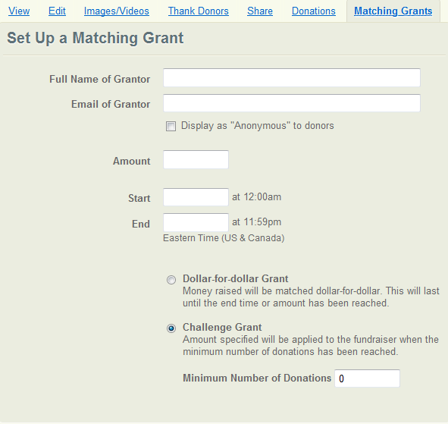
Customize Your Page: Matching Grants
Display a dollar–for– dollar grant or challenge grant on your page to encourage donors to give.
Notes:
The matching grant will only appear on the page it is created on. If an organization has a fundraiser and a project and their main nonprofit page, and puts the matching grant on the main nonprofit page, only donations made through the main nonprofit page will update the match.

Slide 12
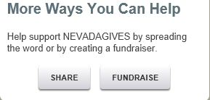
Projects and Fundraisers
Create pages for specific projects or events sponsored by your nonprofit.
Encourage supporters, fans, and board members to fundraise on your behalf.
More information to come in the next training session

Slide 13
Contact
We are excited to see you succeed. Please contact us with any questions or if there is any way we can better support your fundraising efforts. We are here to help!
Support@Razoo.com
866-437-1952
Monday-Friday, 9am-6pm EST

